Slide 2

Role of the citizen
Change of Paradigm in citizen behavior:
From Passive services’ and information consumer
To Active services’ and information provider
OSM as example:

Slide 3
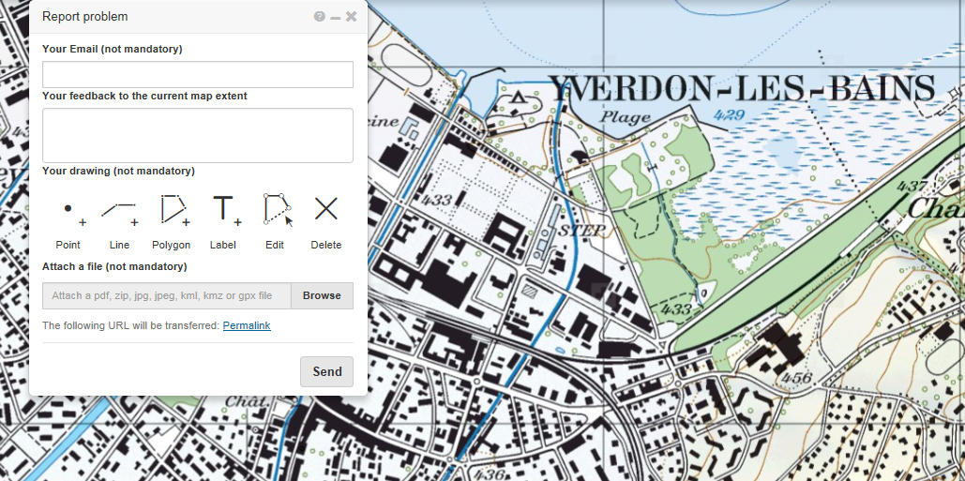
For Mapping and Cadastral agencies?
Well-known Application in the Mapping agencies
map.revision.admin.ch
Why not for Cadastral surveying?

Slide 4
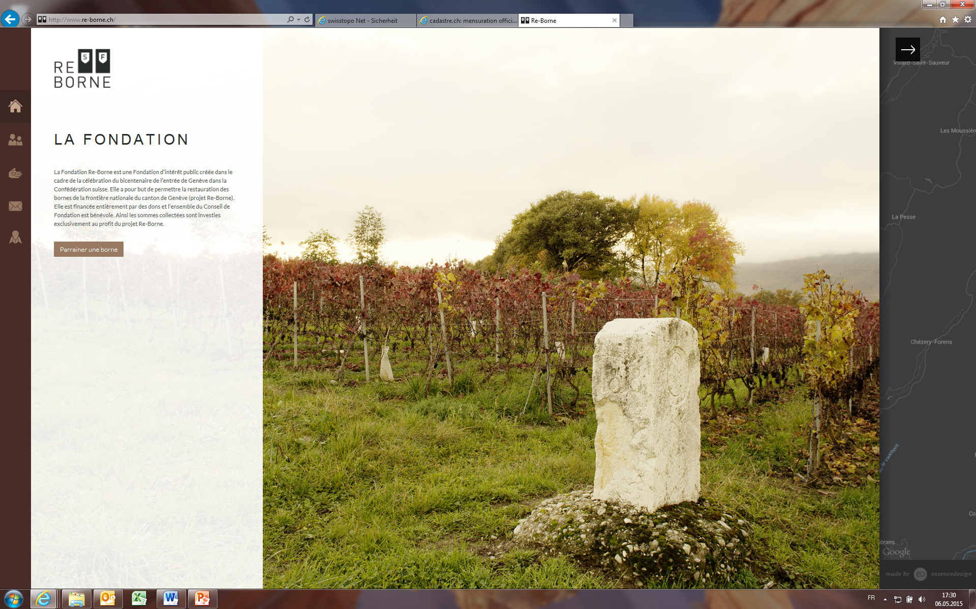
Foundation Re-Borne (Geneva)

Slide 5
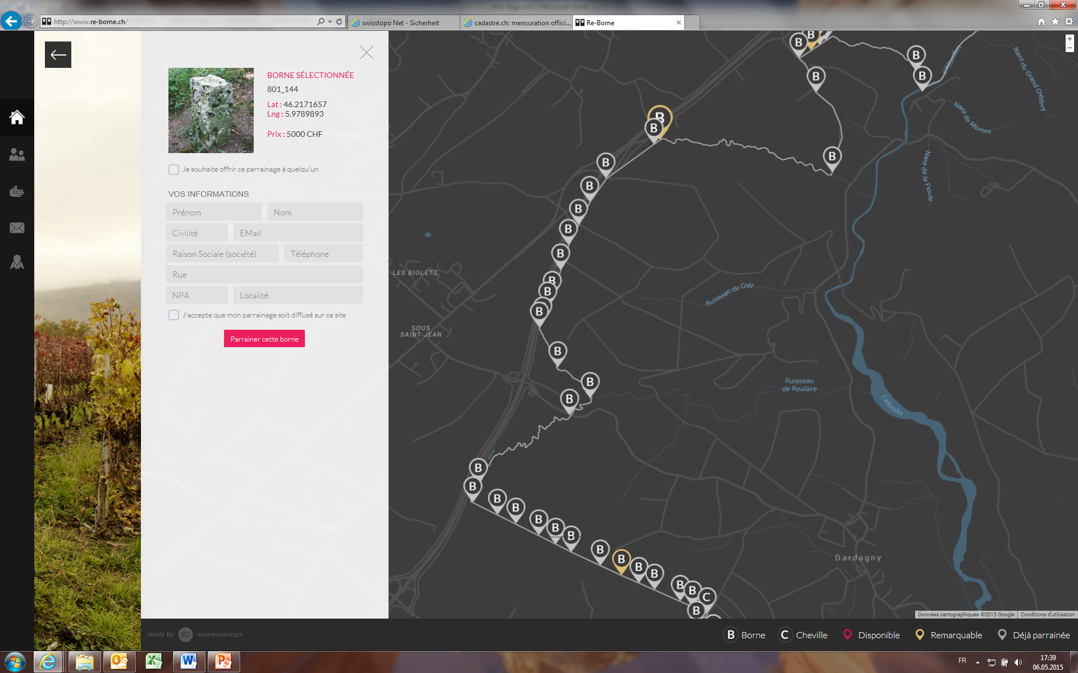
Re-Borne (Geneva) - Principle

Slide 6
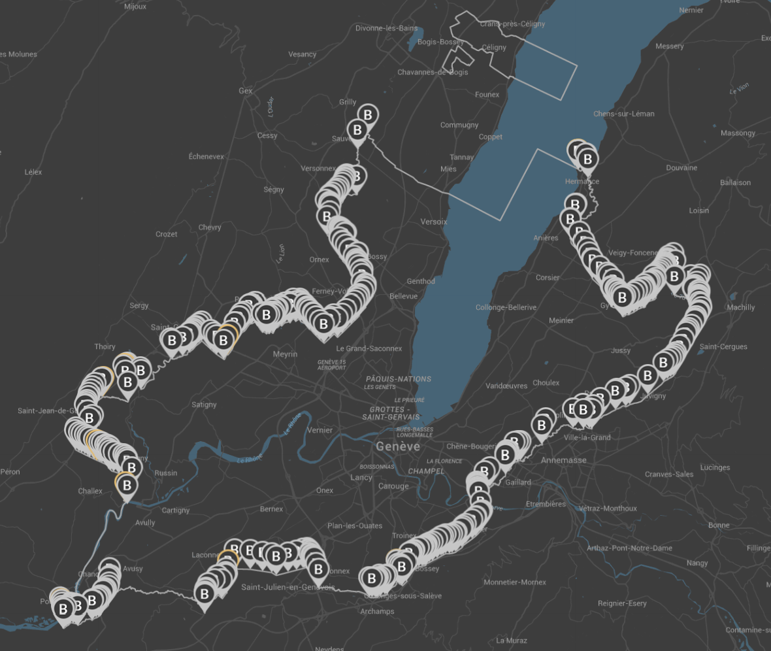
Re-Borne (Geneva) - Result
453 boundary stones (CHF 50 – CHF 5000)
Launching: December 2014
After 1 month, approx. 250 sponsored !!
After 2 months, approx. 400 sponsored !!
Now, only 9 stones not yet sponsored !!
www.re-borne.ch

Slide 7




Citizen participation in Cadastral surveying
Why?
  Costs for updating the cadaster is very high
  for both, citizens and state
  Time for introducing cadastral changes is too long
  Need to valorize the cadastral data available to the public
Partners → CitiGeo Project
  University of Geneva
  Arx iT SA
  Direction de la mensuration officielle (Geneva)
  Federal Office of Topography swisstopo

Slide 8
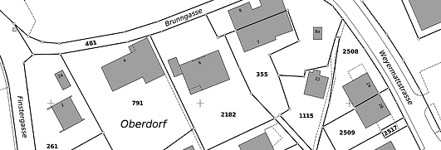
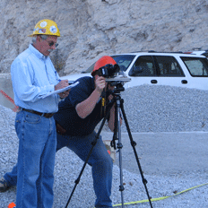
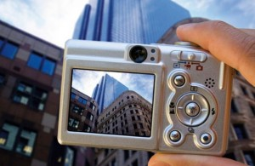
The CitiGeo target
Develop a web service allowing citizens to update the cadastral plan of their property by taking (digital) images of the modifications they have made.
Put the power of Photogrammetry to the hands of the citizens

Slide 9
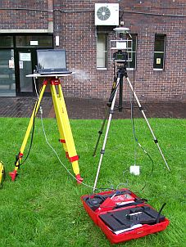
Close Range Photogrammetry
Today:
Exclusively used by professionals
Based on well defined protocols
Using sophisticated equipment

Slide 10
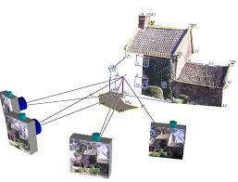
Close Range Photogrammetry in CitiGeo
Using consumer level photo cameras:
Guide the citizen to take digital images of the new construction
Analyze the images and created
a cadastral plan
Integrate this plan to the official cadaster

Slide 11
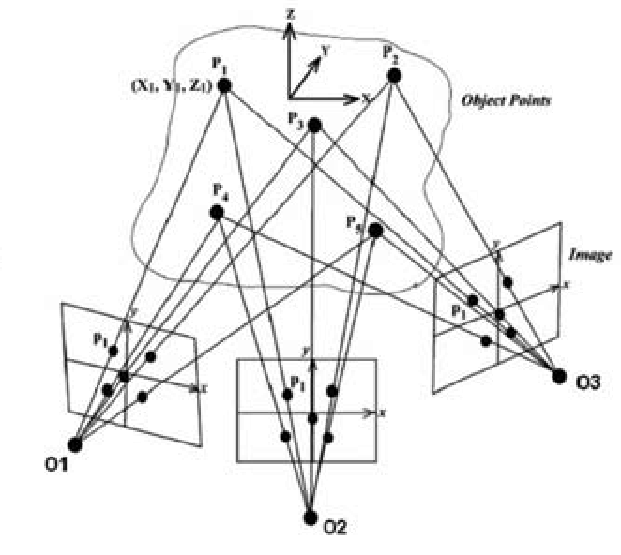
The CitiGeo approach
Based on the known points of the property:
  Building corners, Windows, ….
Taking into account the precision of the existing cadastral plan
Taking into account the quality of the user digital images
Develop the algorithms for identifying the new points (of the construction) and produce the cadastral plan according to the land surveyor standards

Slide 12
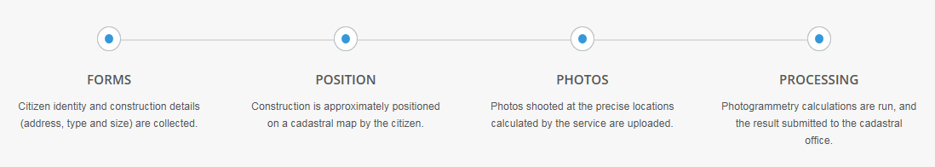
The CitiGeo Service
Web based service:
Property identification in the cadaster
Extraction of reduced set cadaster information
Selection of type of construction
Basic editor for indication of approx. location of new construction

Slide 13
The CitiGeo Service (2)
Calculation of optimal points for images (range, angle, point of view, …)
Visual instructions to the user
Image quality control (resolution, focus, luminosity, …)
Calculation of the points
Creation of the cadastral plan

Slide 14
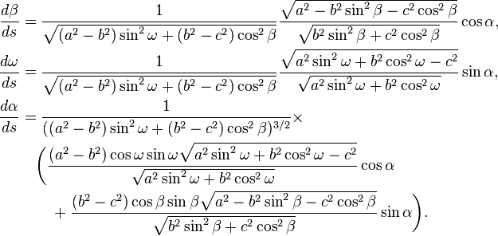
Research challenges
Complexity of the photogrammetry algorithms (failure to come an acceptable precision)
Lack of reference points
Bad image quality
???
??

Slide 15
Time Plan
18 month project (Started March 1st 2015)
Complete functioning prototype after 12 months
Trials with real users
Other usages and future directions
  Ephemeral constructions
  Mobile phone version
  Other services for citizens (ex. reduced mobility guidance)
  Automatic cadaster plan creation

Slide 16
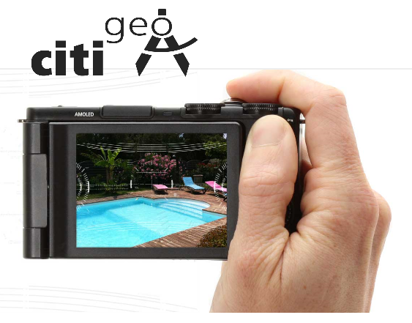

CitiGeo: Contact & Information
Website
citigeo.ch
Contact
Prof. Dimitri Konstantas (Project Coordinator)
dimitri.konstantas@unige.ch
Dr. Lemonia Ragia (Chief Scientist)
lemonia.ragia@unige.ch

Slide 17

Thank you for your attention!
Marc NICODET
swisstopo
Federal Directorate for
Cadastral Surveying
E-mail: marc.nicodet@swisstopo.ch
www.cadastre.ch
www.swisstopo.ch

